Slide 1
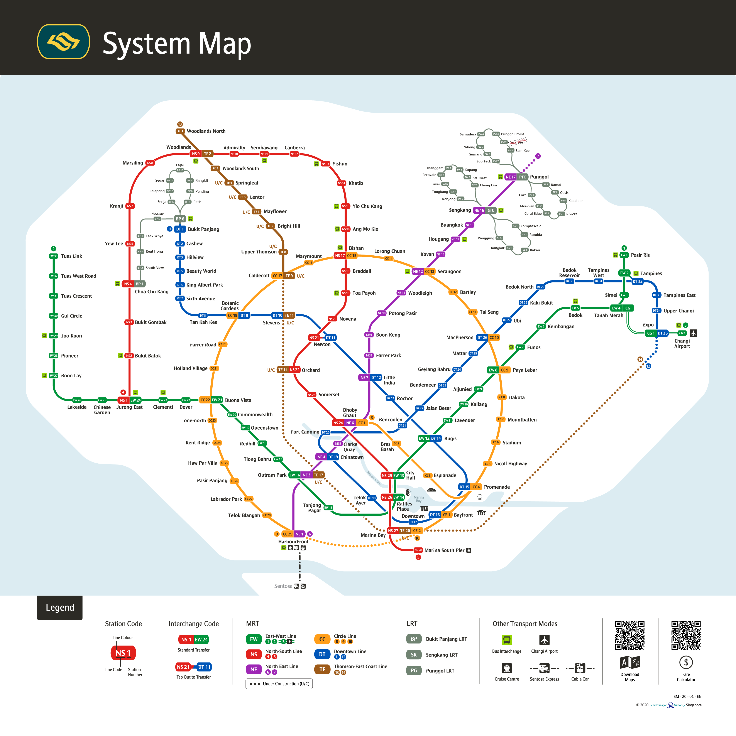
Colour Scheme

Slide 2

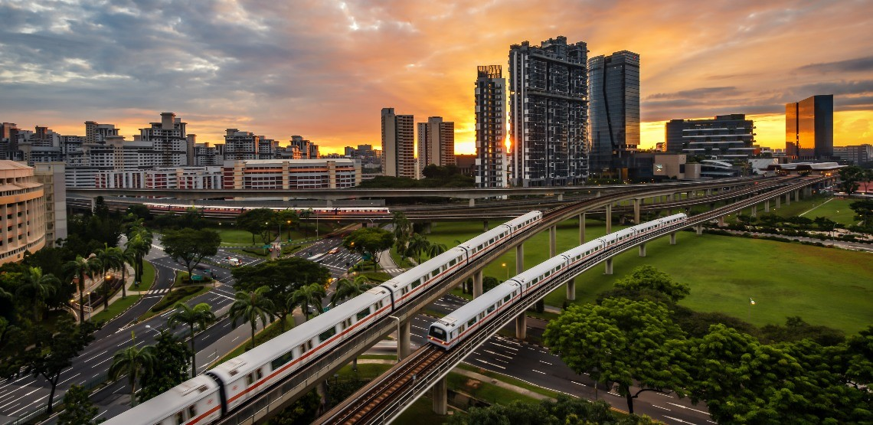
SINGAPORE
World Class Public Transport System
Singapore’s public transport system was ranked third place, just behind Hong Kong and Zurich, according to the Urban Mobility Index Ranking 2023 by Oliver Wyman Forum. This ranking is based on a city’s public transport density, utilization rate and efficiency. Find out how Singapore established a world-class public transport system.
Discover More

Slide 3
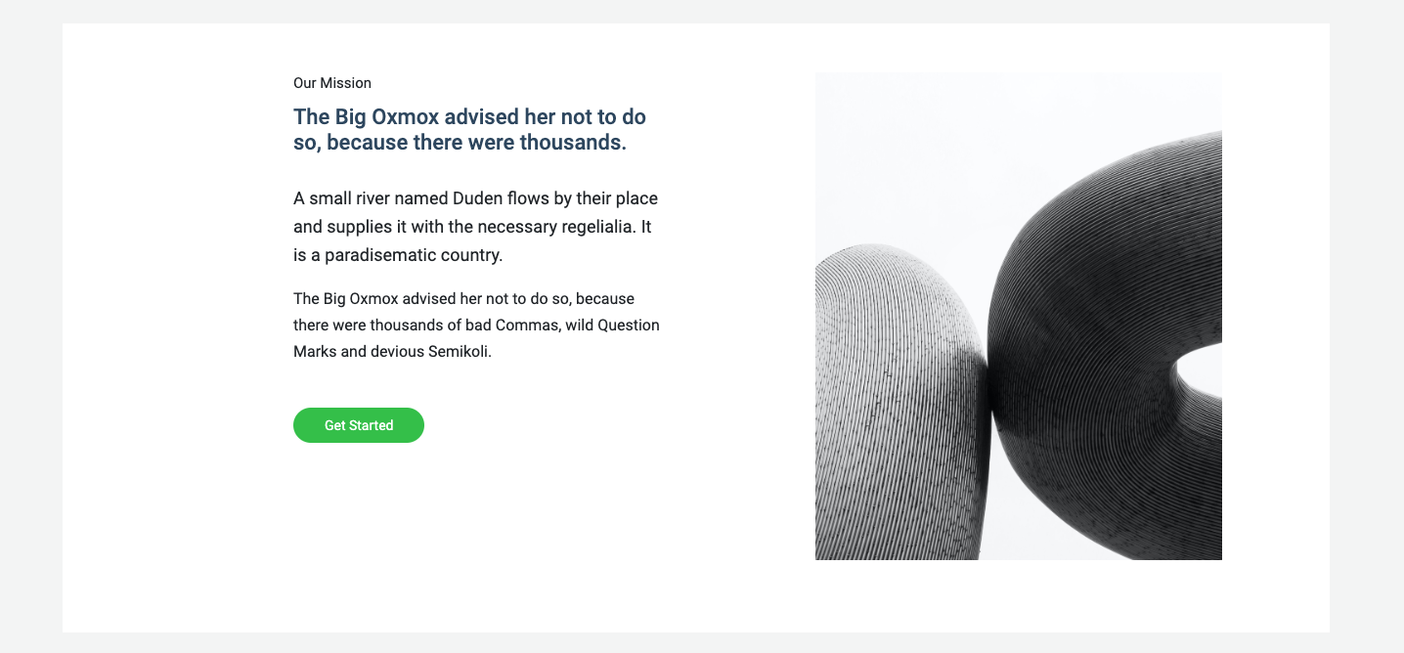
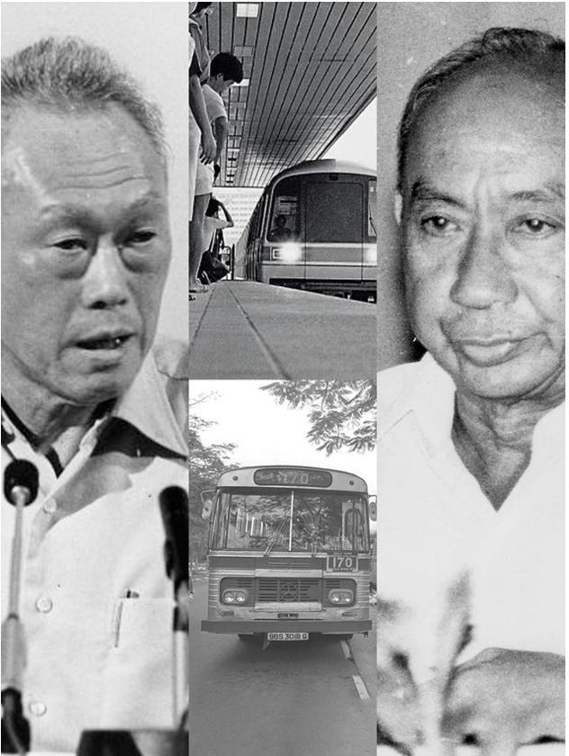
HISTORY
of Singapore’s Public Transport
The efficiency of Singapore’s public transport system primarily emerged from the need to allow large number of people to travel within the limited land space. Singapore was progressing rapidly and there was an urgent need to limit the number of private vehicles on the road to relive the severe traffic congestions in the 1970-80s.
In the 1950s, buses was the primary mode of public transport. The rail system was proposed and launched in 1980s to serve the rapidly growing population and ease traffic congestion.
Fast forward to May 2019, the Land Transport Authority released the Land Transport Master Plan 2040 that set a goal to transform the nation into a 45-minute city and 20-inute town by 2040.

Slide 4
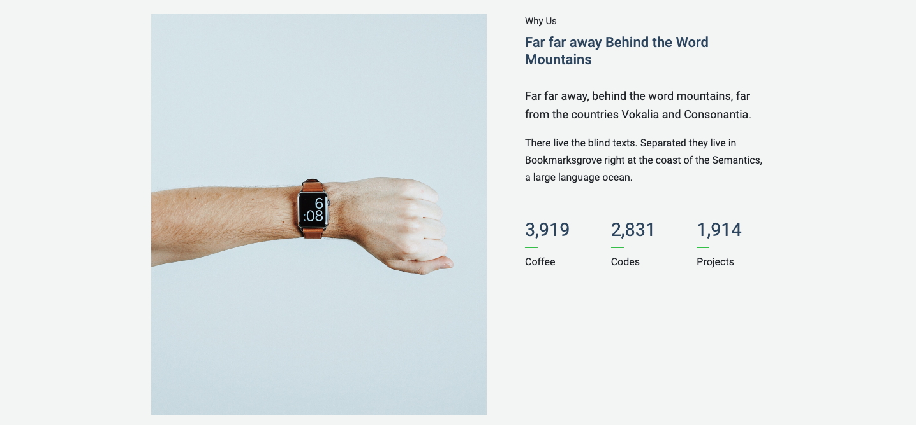
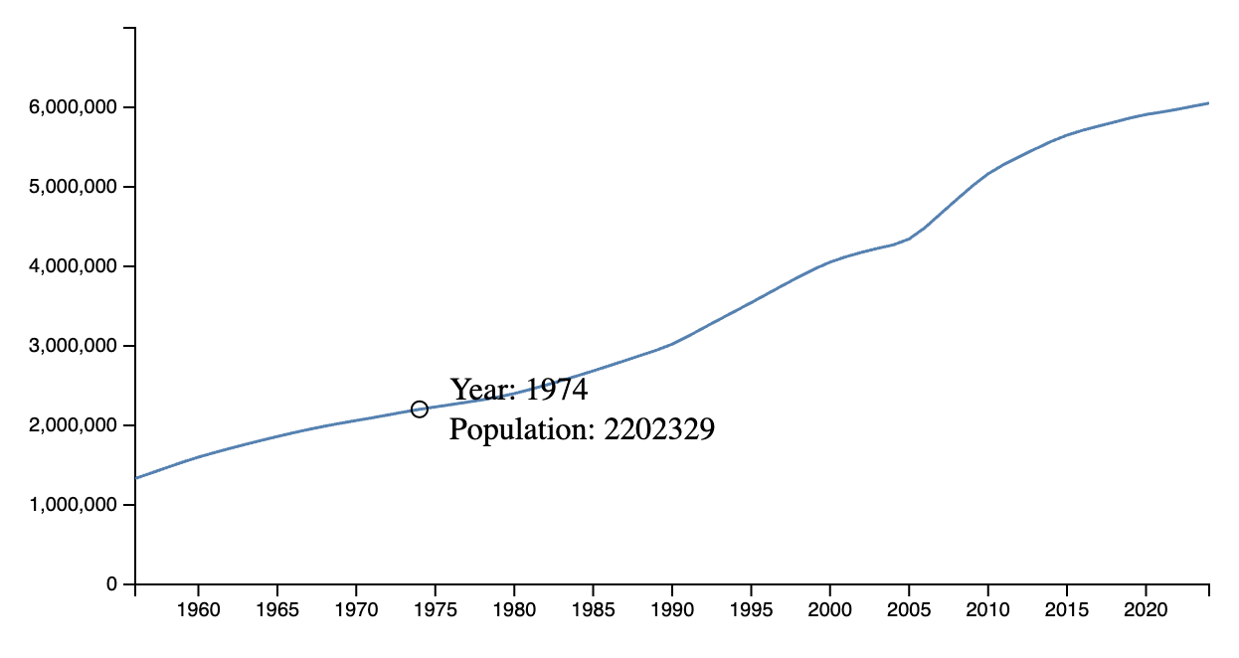
CATERING
to Singapore’s Growing Population
Singapore’s strategic location made it ideal to be an international trade and commerce hub, attracting an influx of foreign human capital. The nation is now known to be Asia’s most densely populated country and its population size is projected to continue to grow. To cater for this population growth, there is a strong pressure to ensure an efficient public transport system that can move millions of passengers
6
140
397
MRT lines
MRT stations
Public bus routes

Slide 5

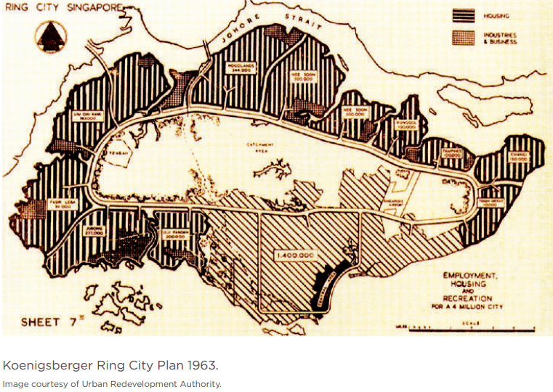
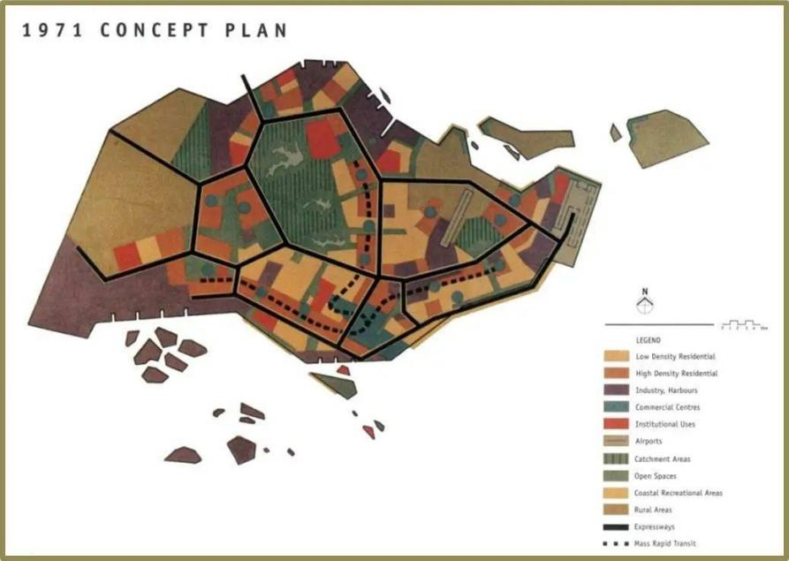
EVOLUTION
of Singapore’s Public Transport System
1960s
In 1963, a report from the United Nations Development Program (UNDP) suggested Singapore should invest in monorail or subway systems as it will suit the city landscape and is a cost-effective option.
1970s
In the 1971, the Urban Redevelopment Authority (URA) proposed a concept plan to resolve the lack of space planning. Part of the plan included a rail system to serve as the ‘veins’ of the system to connect the city center and satellite towns.
2000s
By the early 2000s, Singapore’s urban public transport infrastructure became a pioneering example of a ‘transport metropolis’ in the world.

Slide 6

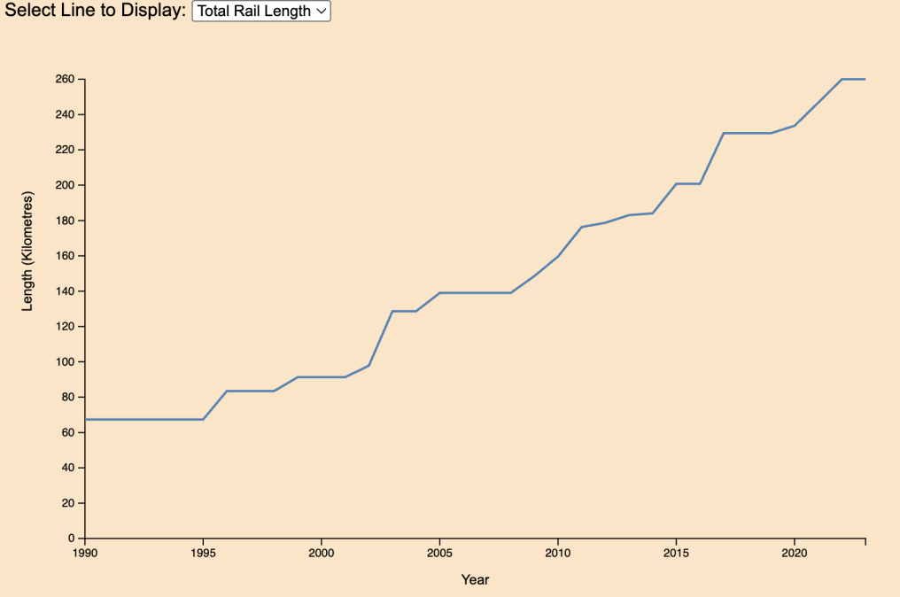
Rail network from 1990 – 2023
XXX
Public Transport Ridership in 2019
XXX
Public Motor Vehicle Population from 1990 – 2024
XXX

Slide 7

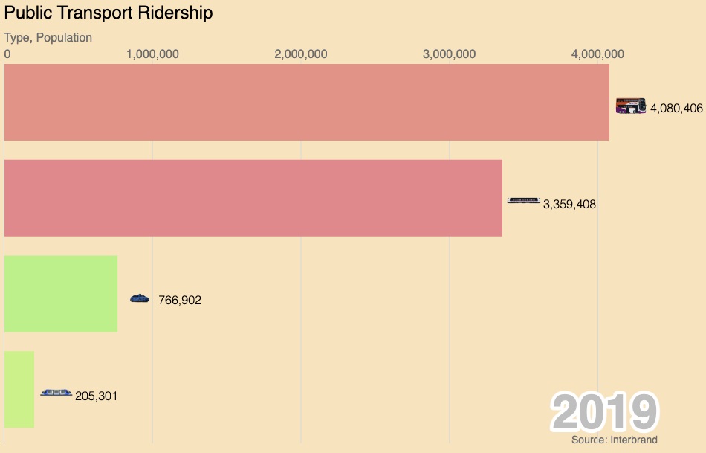
Rail network from 1990 – 2023
XXX
Public Transport Ridership in 2019
XXX
Public Motor Vehicle Population from 1990 – 2024
XXX

Slide 8

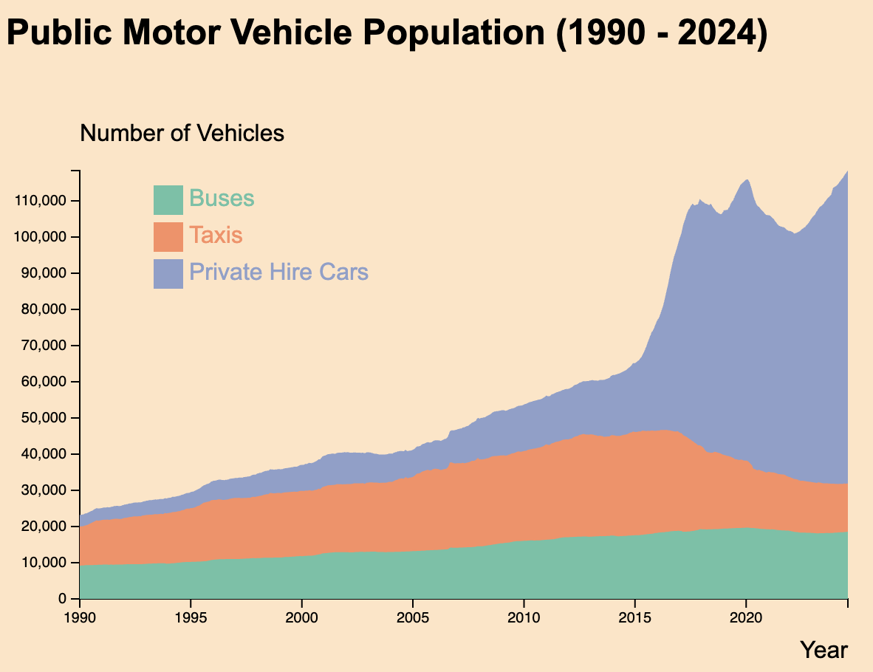
Rail network from 1990 – 2023
XXX
Public Transport Ridership in 2019
XXX
Public Motor Vehicle Population from 1990 – 2024
XXX

Slide 9
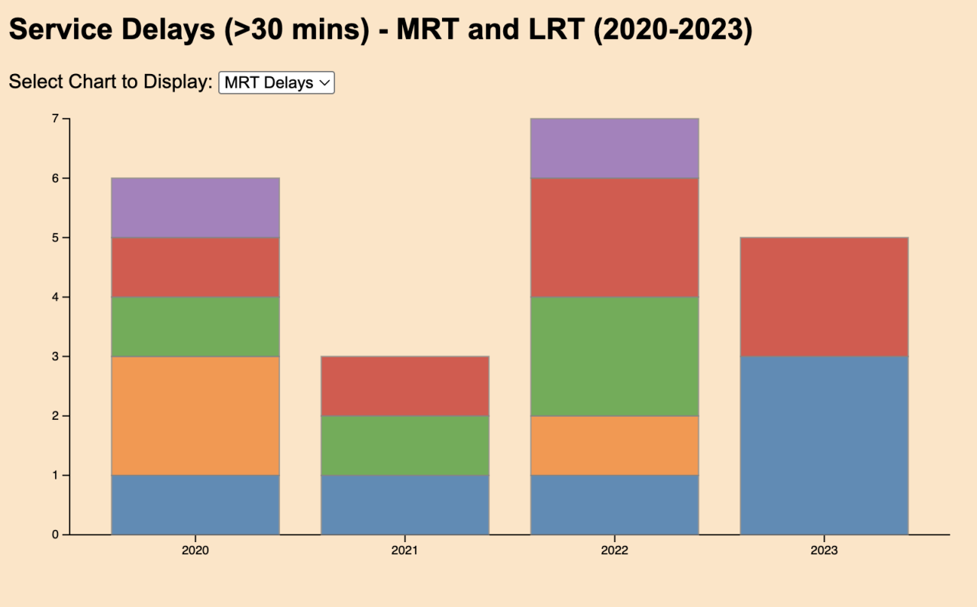
CHALLENGES
facing Public Transport System
Despite the exceptional system, the greatest challenge that would cripple the system is the presence of service delays. The biggest disruption till date is the incident on 25 September 2024 where a faulty train damaged the tracks on the East-West Line, leading to a 6-day disruption. This is the longest service disruption in Singapore’s MRT history and is estimated to have affected more than 800,000 people.

